Slide 1
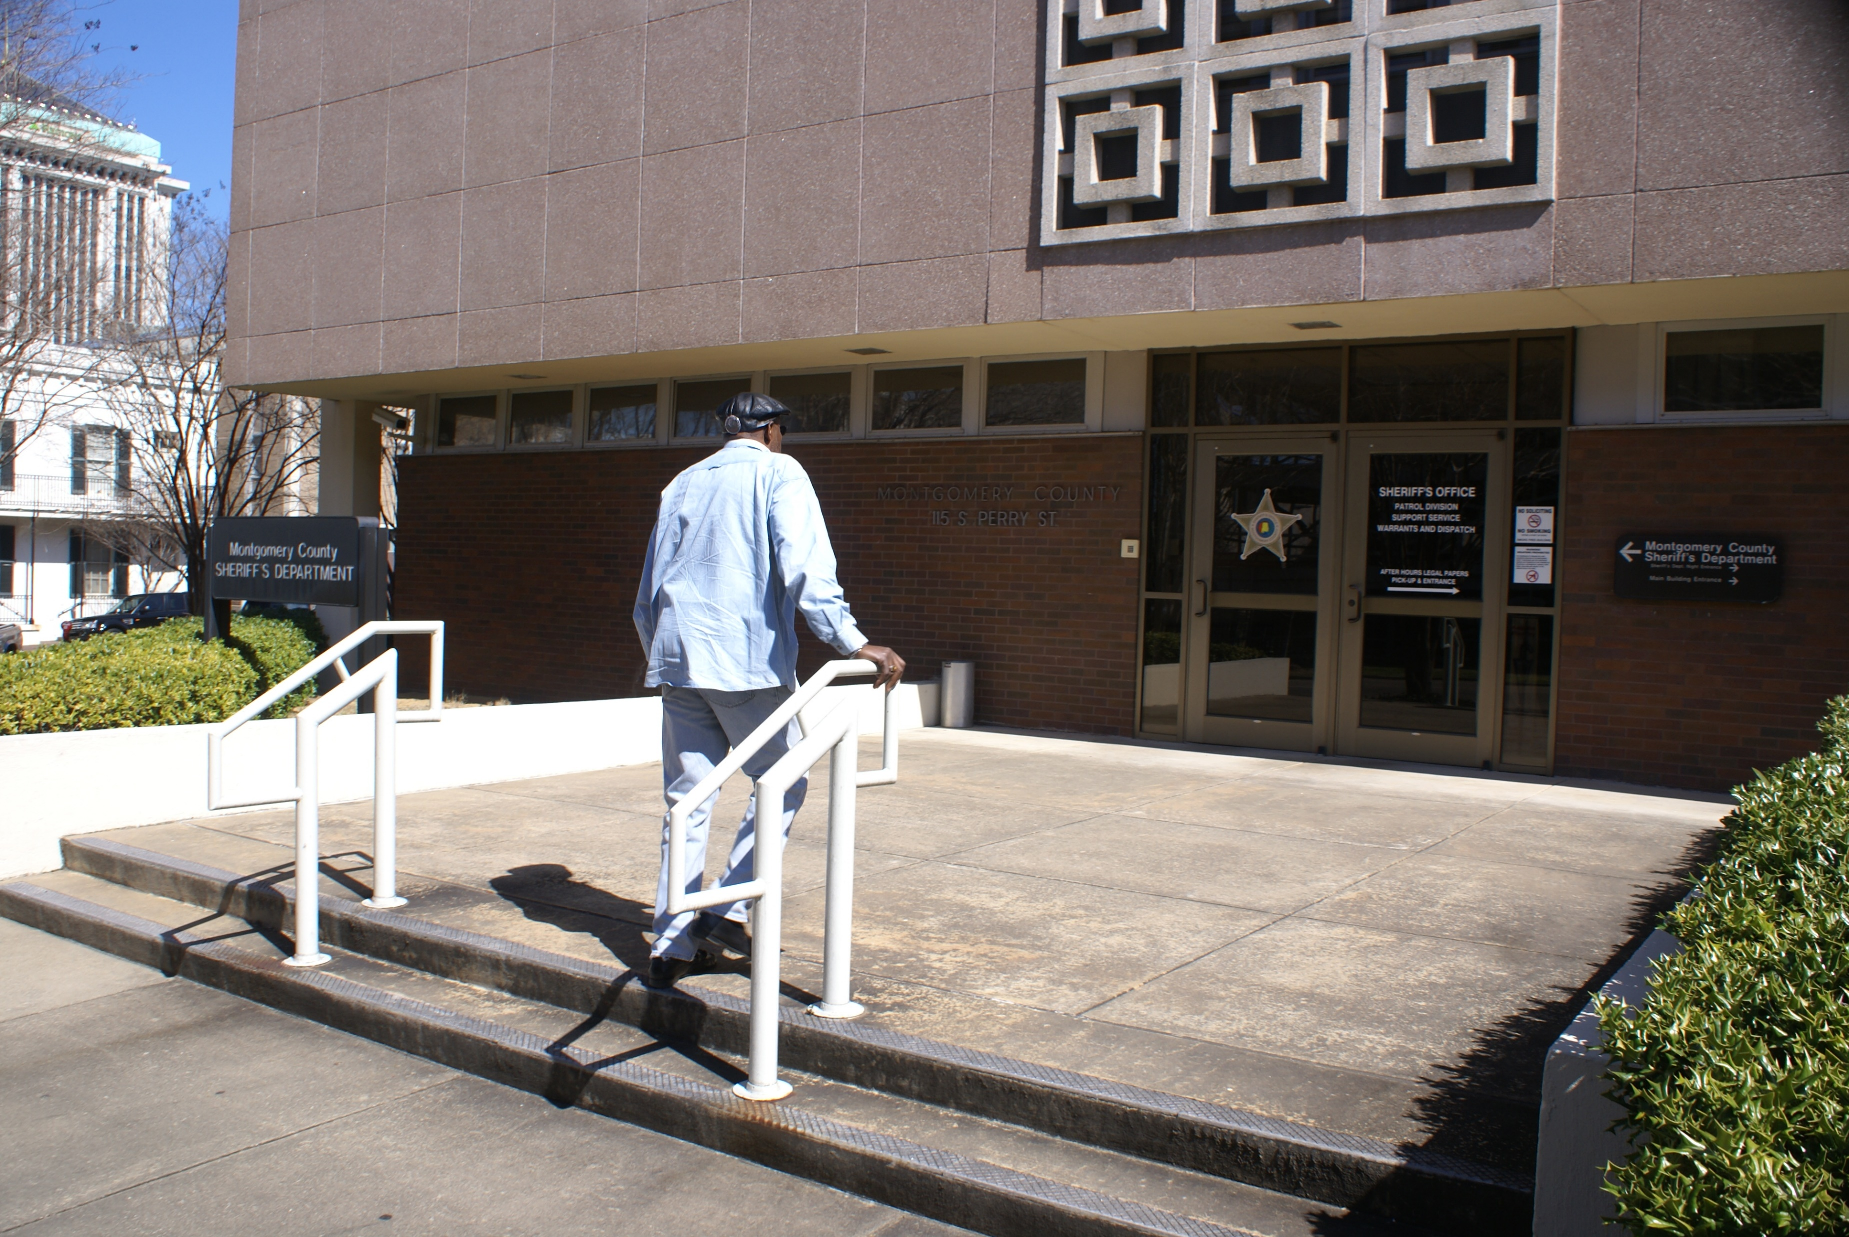
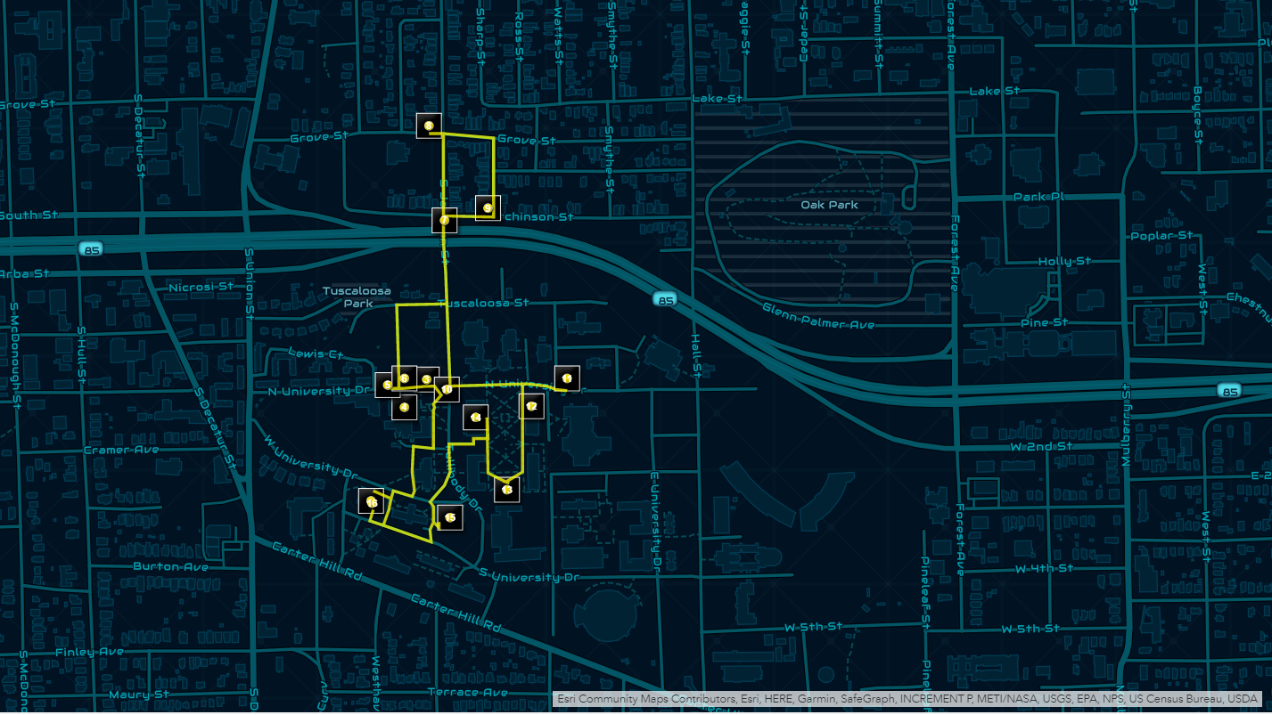
Montgomery 1960
“May we continue to sit-in, stand-in, wade-in, and wait-in until freedom rings from every mountain side, yes even southern mountain sides” – Reverend Ralph David Abernathy 1960
Background
In 1960 the Civil Rights Movement was gaining traction. On February 1st, 1960, students in Greensboro started a sit-in movement that would inspire others. Soon after on February 25th, 1960, students at Alabama State College held a sit-in of their own at the Montgomery County Courthouse Café.
While they were not arrested, the 9 ‘ringleaders’ were expelled from ASC at the direction of Governor Patterson, and more were placed on probation. One of the students, John Dixon, filed a lawsuit against the State of Alabama with the help of legendary attorney Fred Gray. Dixon v the State of Alabama became the foundation to due process rights that students enjoy today.
Importance
Despite ending the practice of loco parentis in higher education, this case and the people involved are not well known. The Montgomery 1960 Project was started to research and compile information into a database to educate students about the Civil Rights Movement. Further, Dr. Boyd and Dr. Staples hope to continue with creating an educational game for students to play through as a way to build empathy and perspective-taking skills.
My Involvement and Research
For the first half of the summer, I worked with the rest of the History sub-team on researching every aspect of the activists’ lives and motivations. As we got further into the project, Dr. Boyd reassigned me to working on a mapping project. In 2010, she accompanied Mr. McFadden on a tour of the most important spots around Montgomery to the planning of the sit-in movement and took pictures along the way of these spaces.
I was given the pictures and the audio recording from the car ride and set out to create a rough draft of a walking tour map of the places near the ASU campus. Many of the spots important to the activists have been destroyed by the city, such as the Hornet Grill, where Dr. Martin Luther King Jr. would meet with Reverend Abernathy to discuss the movement.
Going Forward
I am graduating this December and for my final semester I have decided to take an independent study hour through the Geography Department to partner with Dr. Boyd and continue working with the Montgomery 1960 team. The map I created for this summer is a rough draft of what I would like to create moving forward.
Top: Mr. James McFadden at the original location of the Montgomery County Courthouse (Now the Sherriff’s Office). He believes this is the door they entered to get to the café.
Bottom: The Map prototype I created with the locations that Mr. McFadden highlighted on his tour of Montgomery with Dr. Boyd. In the future, this will be an interactive walking tour.
Mary Bennett
SURGE

